Slide 1

DATA PROGRAMMING FINAL PROJECT

Slide 2




Team Members
Bhuvan Chalasani Albin Reji Vardharaj Konar Gnana Pradeep Chodavarapu

Slide 3
Description
Our Data Programming Final Project focuses on analyzing AAPL (Apple Inc.) stock prices using Python, Flask, and MongoDB. The project involves several key components:
1. Data Visualization:
- WE created various charts to visualize AAPL stock data. These include:
- A line graph displaying the open and close prices of AAPL stock over time, highlighting trends and fluctuations.
- A graph showing the trading volume of AAPL stock, which helps identify periods of increased market activity.
- A bar chart comparing the highest and lowest prices of AAPL stock within a selected timeframe.
- A comparison of the average opening price of AAPL stock over the recent 90 days.
- A bar chart comparing the opening and closing prices of AAPL stock over consecutive trading days.
2. Backend Development:
- The backend of your project is built using Python Flask, where the application fetches data from an API and stores it in MongoDB.
- The Flask application is configured to run a background scheduler that updates the AAPL stock data every 24 hours, ensuring that your visualizations are always based on the latest data.
3. Data Management:
- The AAPL stock data is stored in a MongoDB collection named "AAPLStock," which contains detailed information such as opening, closing, high, and low prices, along with trading volumes.
- This data is retrieved and displayed through your web application, providing users with real-time insights into AAPL's stock performance.
Overall, your project offers a comprehensive analysis of AAPL stock, combining real-time data acquisition, storage, and visualization to help users understand the stock's market behavior.

Slide 4
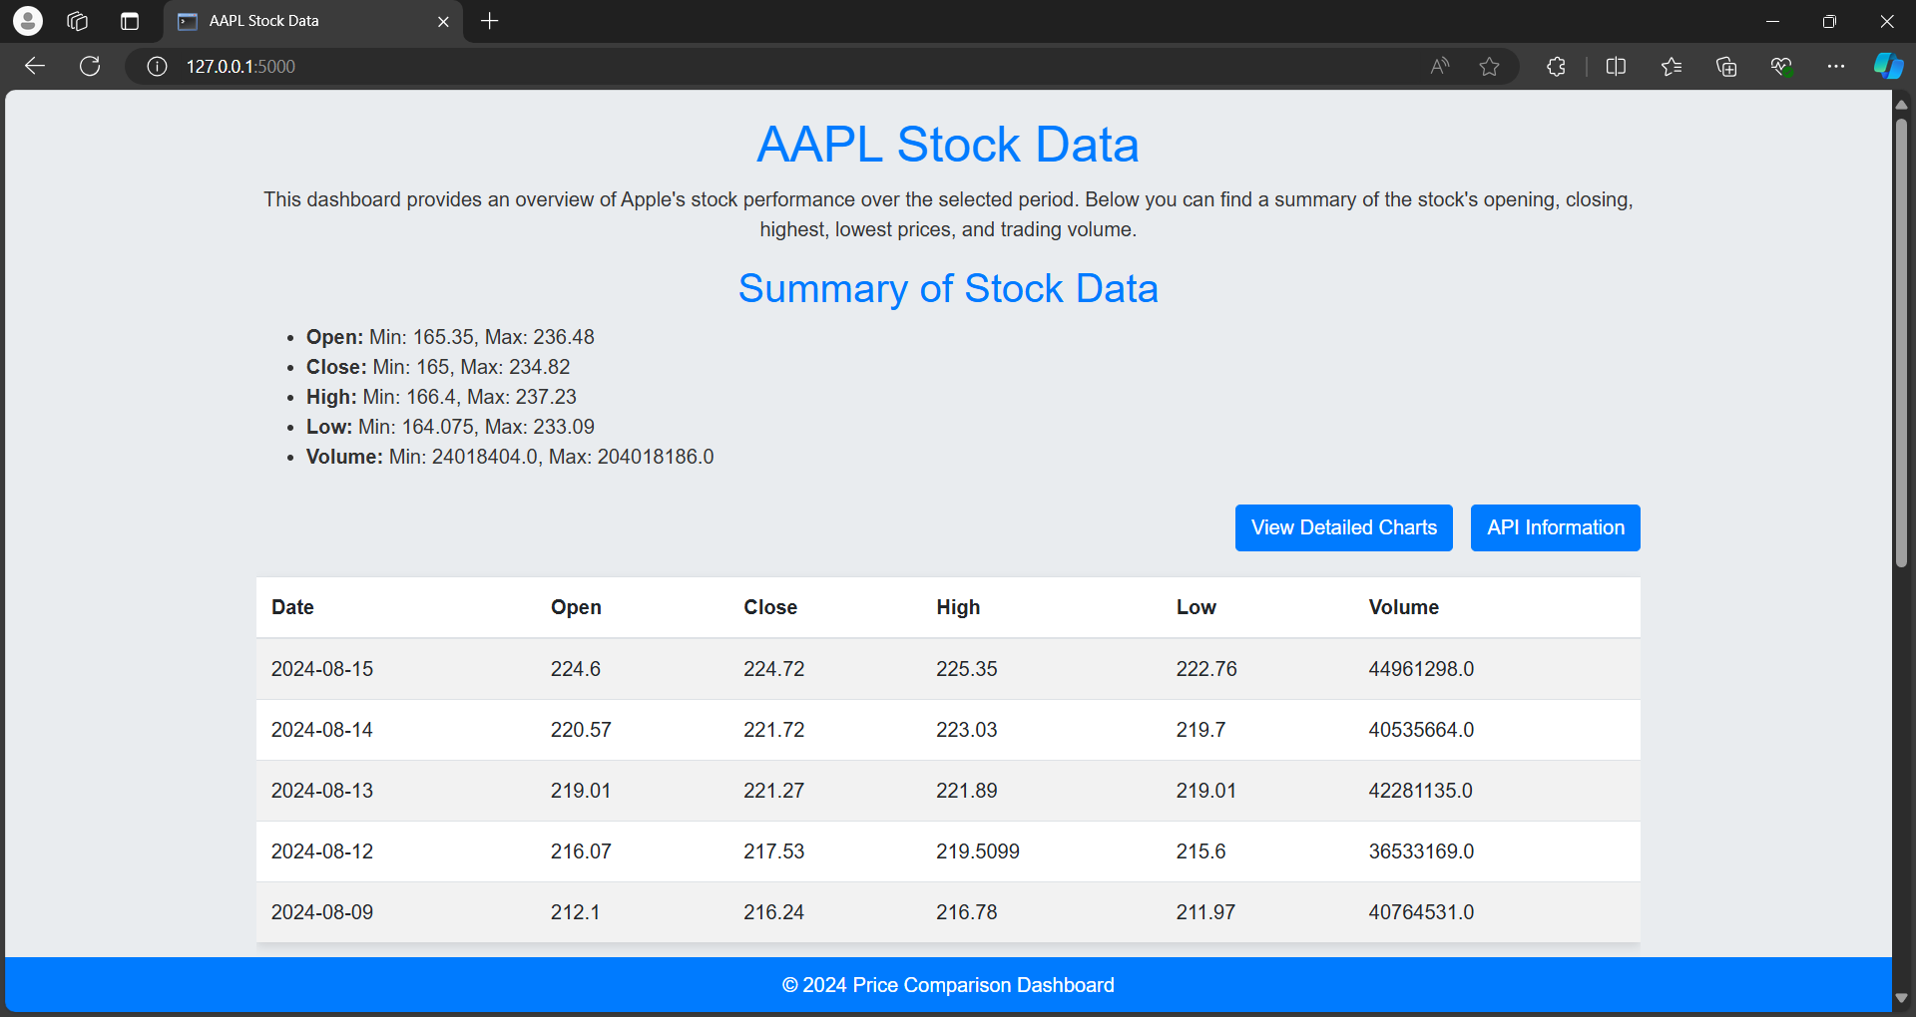
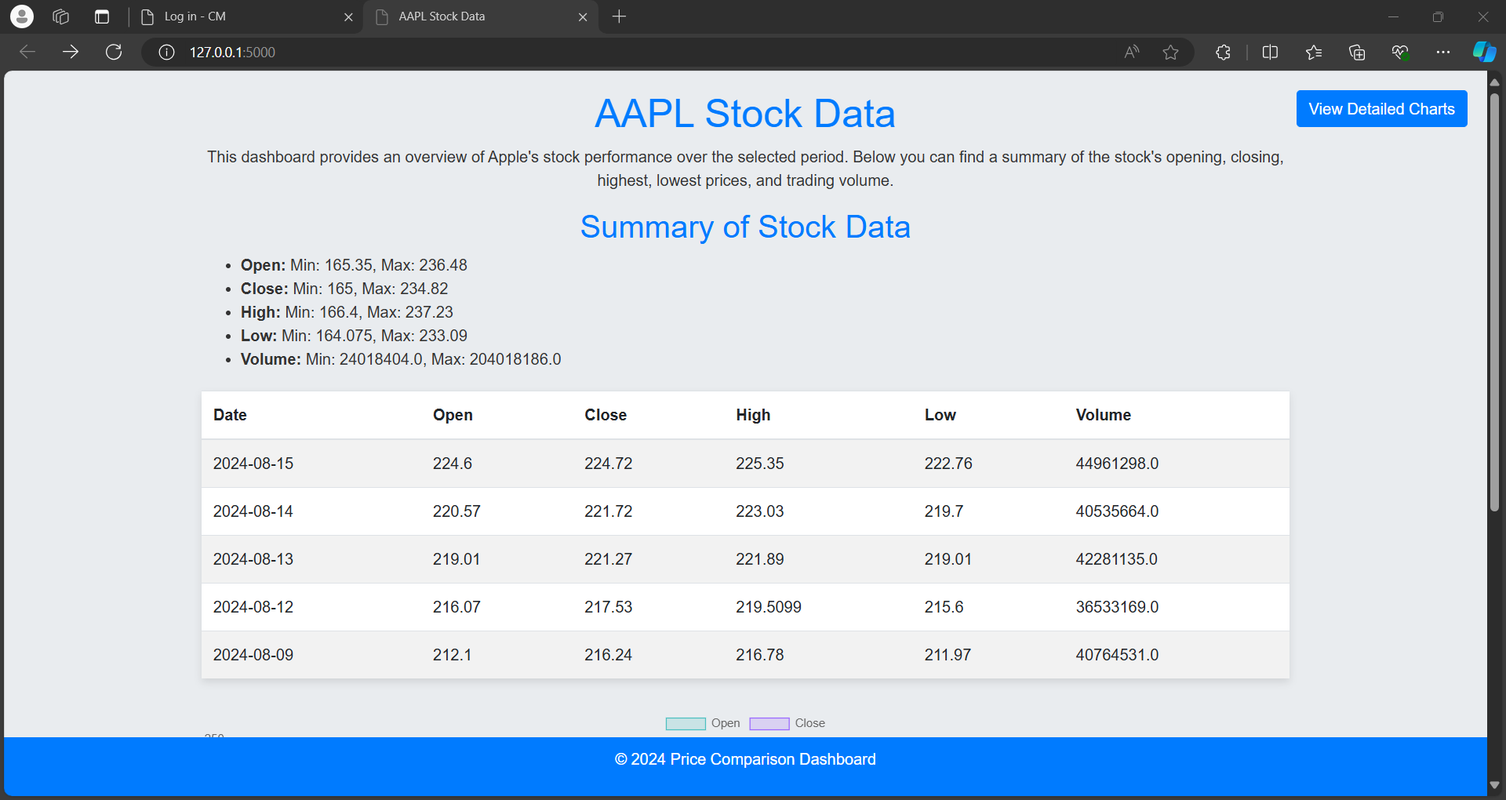

Slide 5
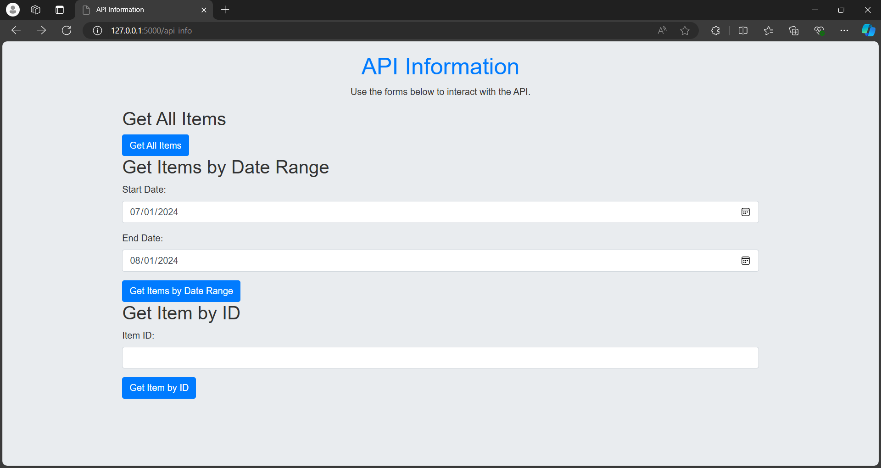
Front-End

Slide 6
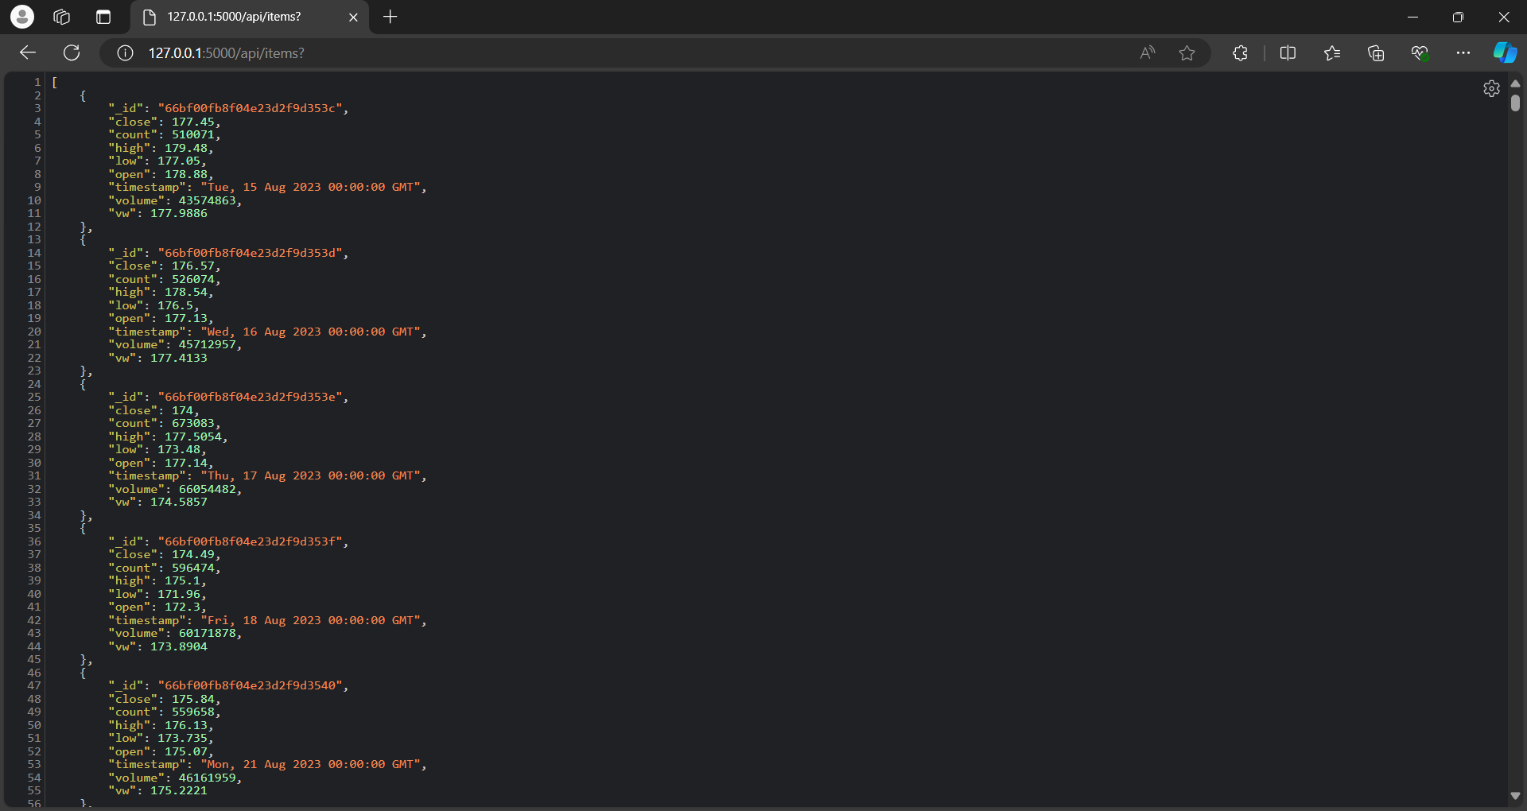
This screenshot displays raw JSON data fetched from an API, representing stock market information for a specific date range. Each entry includes details such as the stock's close, high, low, and open prices, as well as the trading volume and count for each day. The timestamp field indicates the specific date and time of each record. This type of data is typically used for further processing, analysis, or visualization in a web application or data analysis tool, providing a structured format for storing and retrieving stock market data.

Slide 7
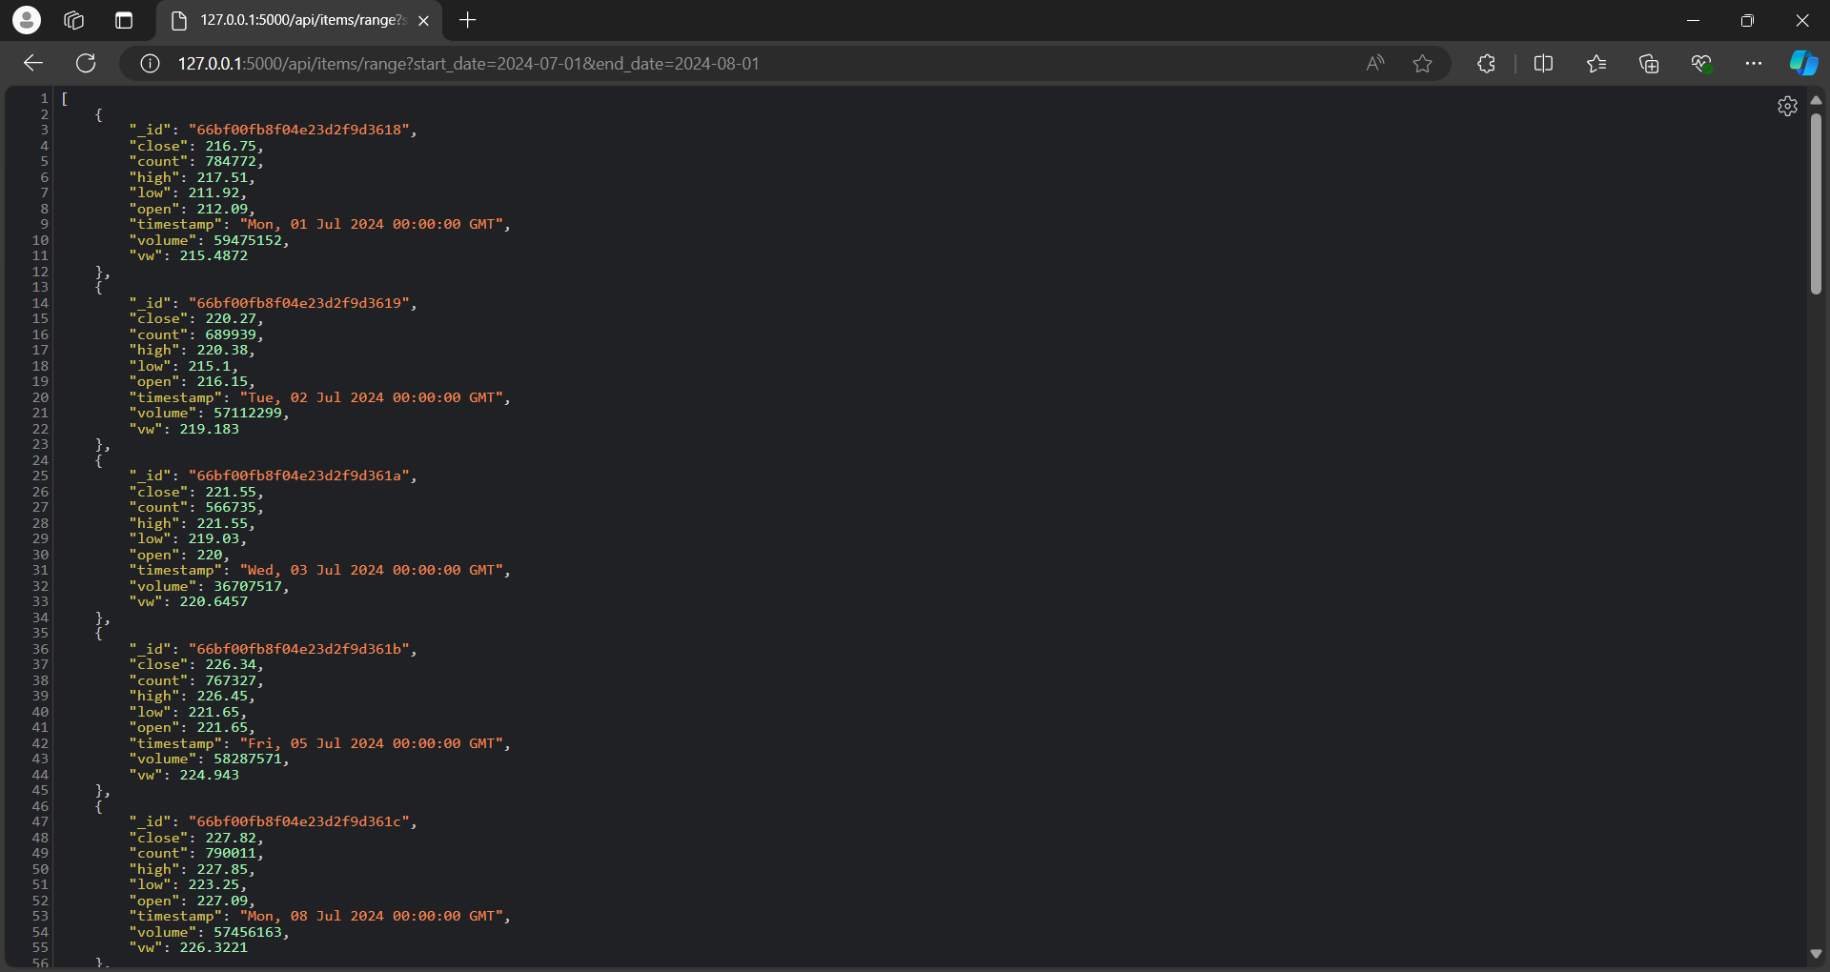

Slide 8
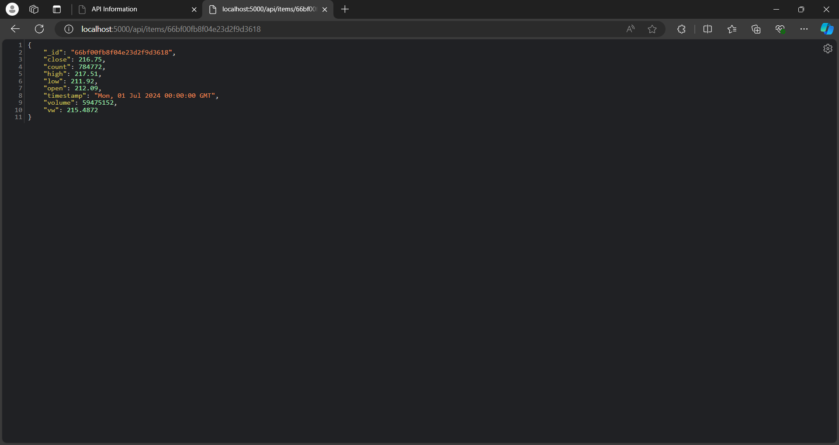

Slide 9
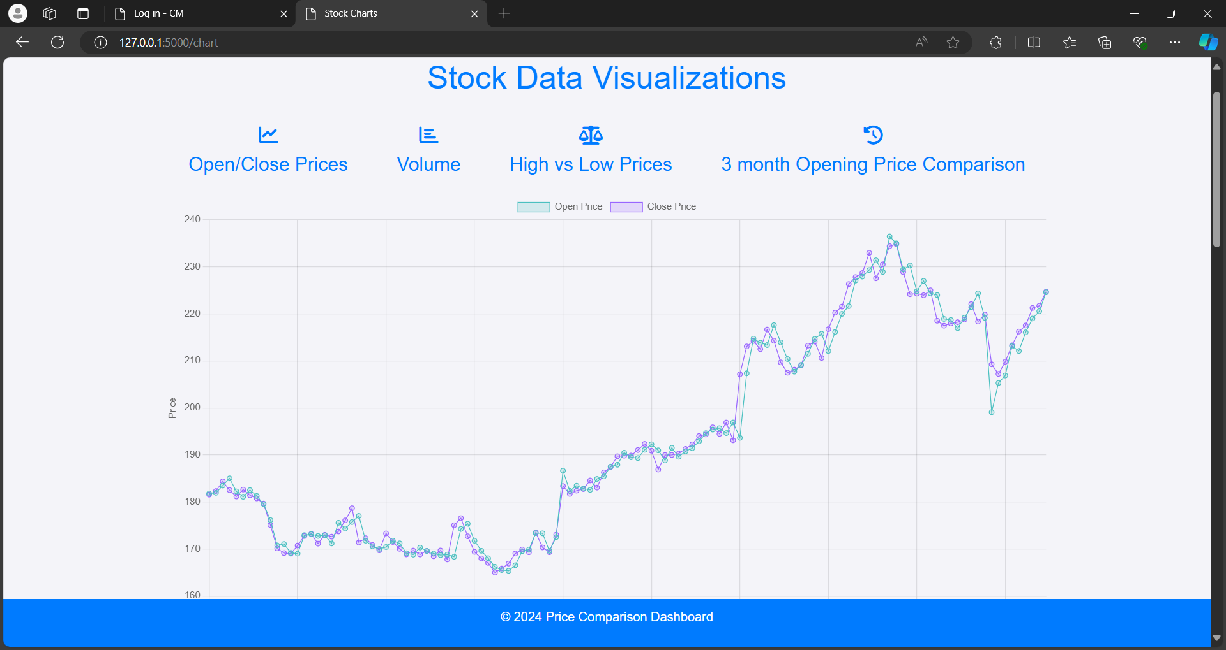

Slide 10
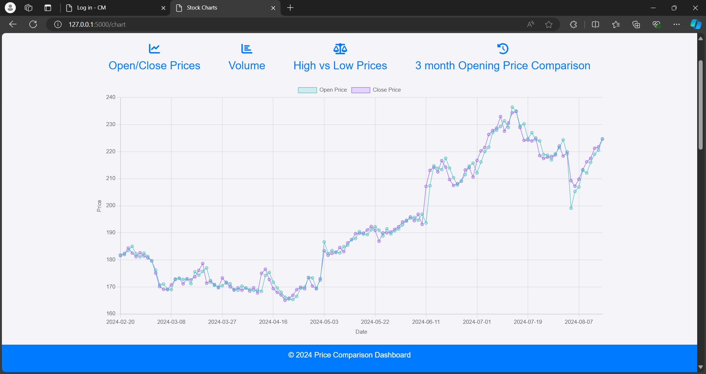
This graph displays the open and close prices of AAPL stock over time. The cyan line represents the open prices, and the purple line represents the close prices. The chart provides a visual representation of how the stock's price starts and ends each trading day, allowing for easy identification of trends and fluctuations in the stock's performance. The upward and downward movements in the graph highlight the volatility of the stock and its overall trend over the selected period. This type of visualization is useful for analyzing stock market behavior and making informed decisions.

Slide 11
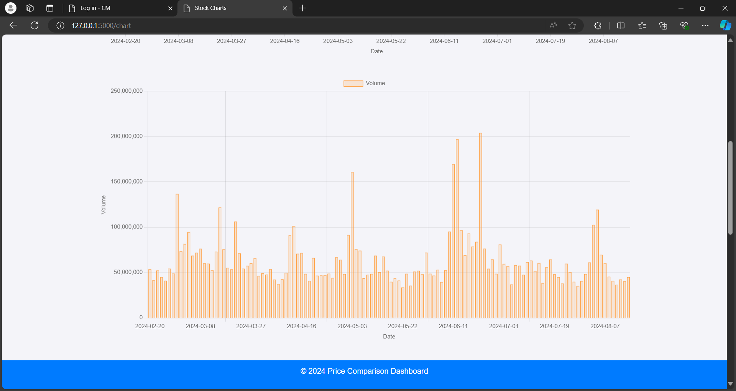
This graph displays the trading volume of AAPL stock over a selected period. The x-axis represents the date, while the y-axis shows the volume of shares traded. The graph highlights fluctuations in trading activity, with certain dates showing significantly higher volumes compared to others, indicating periods of increased market activity or interest in the stock. The data visualization helps to analyze the trading patterns and understand the trends in AAPL's market behavior.

Slide 12
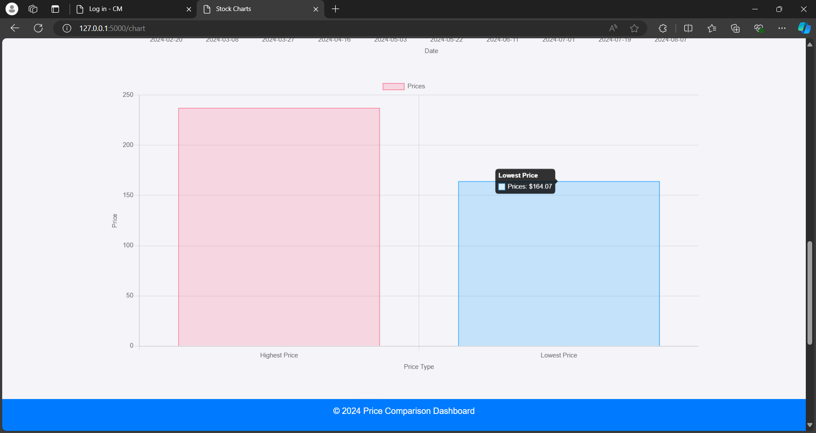
This graph compares the highest and lowest prices of AAPL stock within a given timeframe. The red bar represents the highest recorded price at $237.23, while the blue bar represents the lowest recorded price at $164.07. This visualization provides a clear contrast between the peak and trough in the stock's price, helping to identify the range of price fluctuations over the selected period.

Slide 13
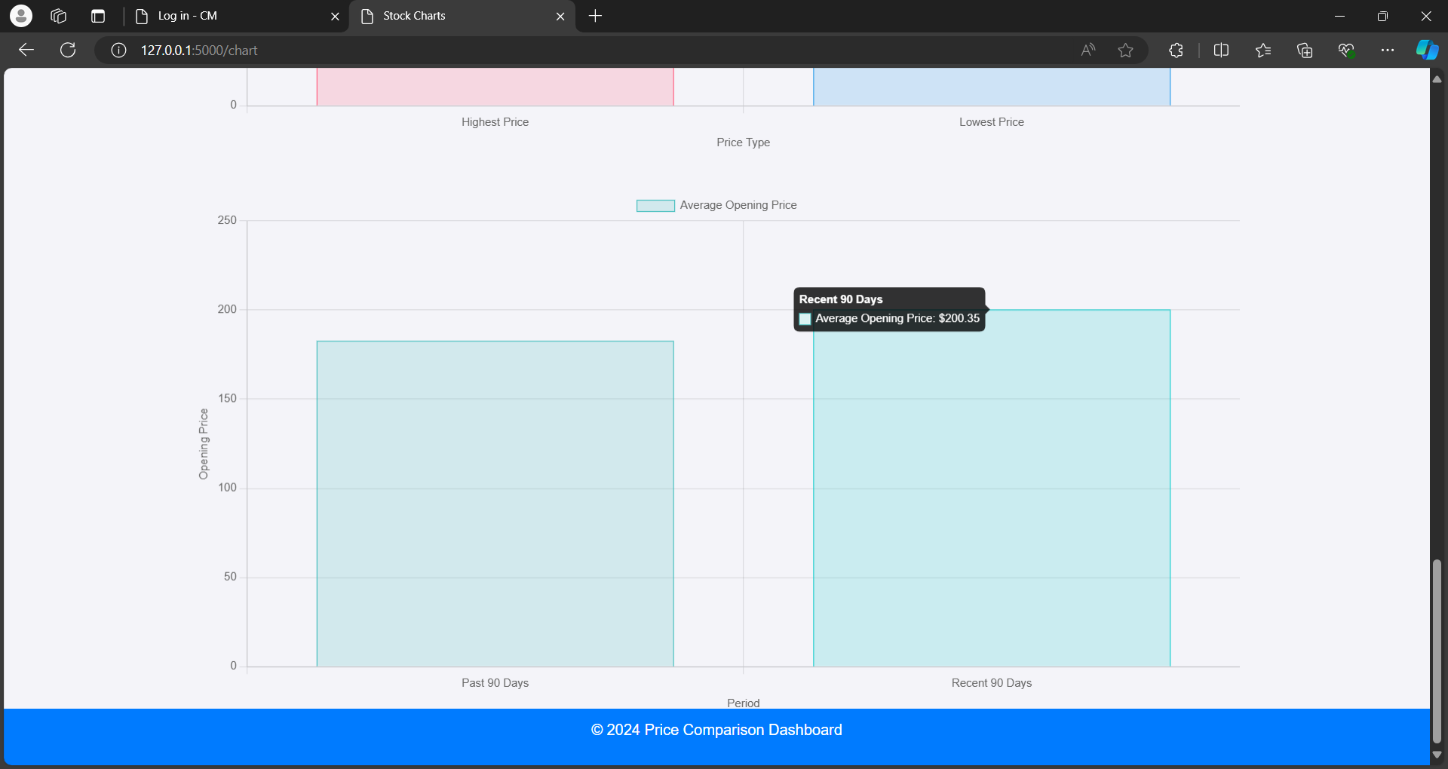
This graph compares the average opening price of AAPL stock over the recent 90 days. The bar shows that the average opening price during this period was $200.35. This visualization helps to identify the general trend of the stock's opening price over a significant time frame, offering insights into how the stock has performed recently at the start of trading days.

Slide 14
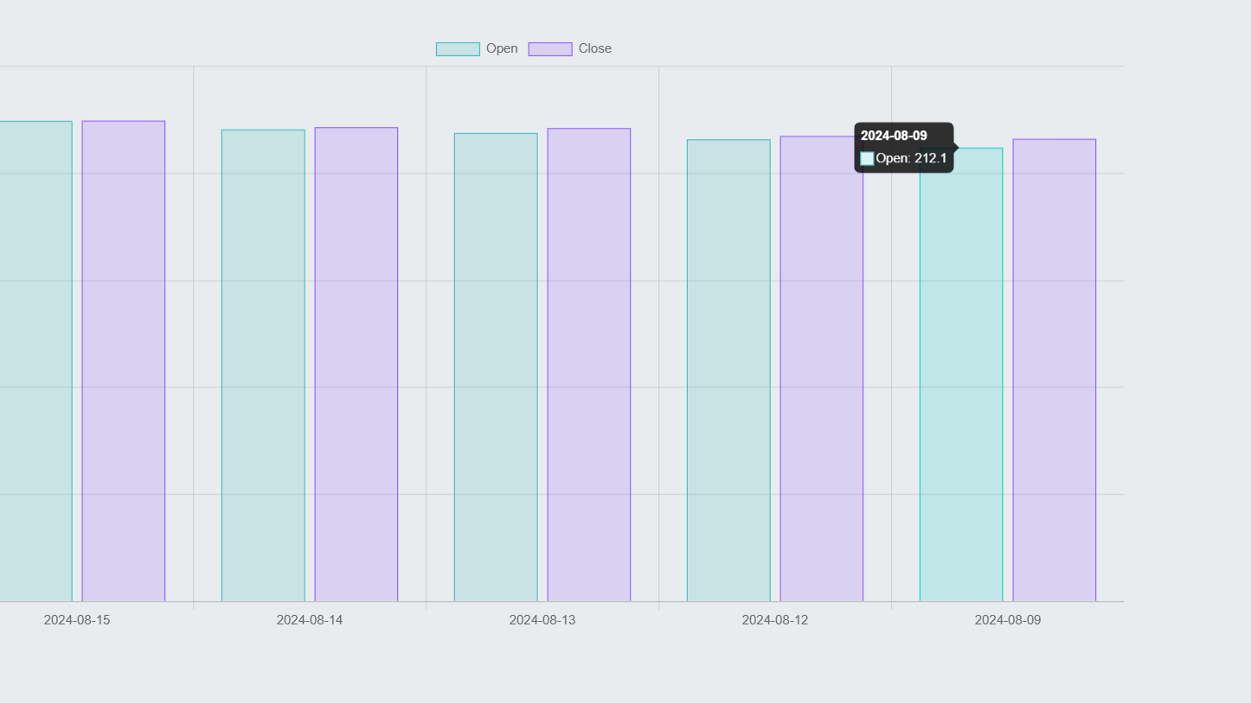
This graph compares the opening and closing prices of AAPL stock over a series of consecutive trading days. The cyan bars represent the opening prices, and the purple bars represent the closing prices. The graph provides a visual comparison of how the stock's price changed within each day, showing whether the stock closed higher or lower than it opened. This type of chart is useful for analyzing daily price movements and identifying trends in the stock's performance over time.

Slide 15
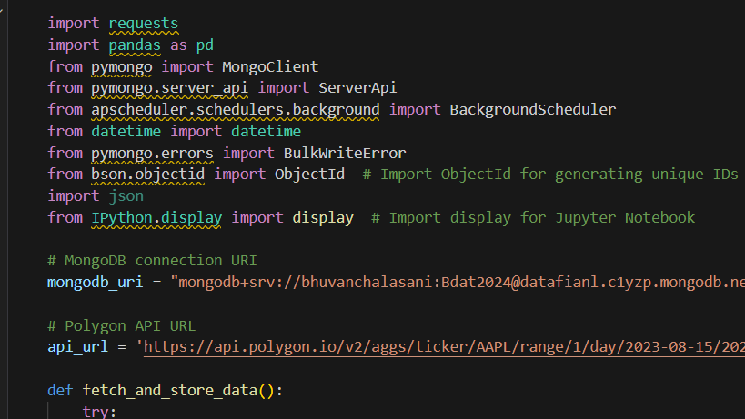
Back-End Code

Slide 16
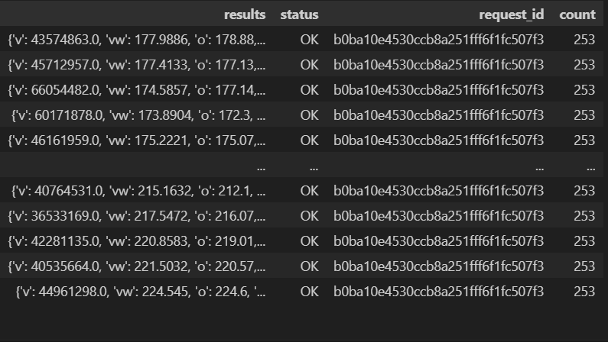

Slide 17
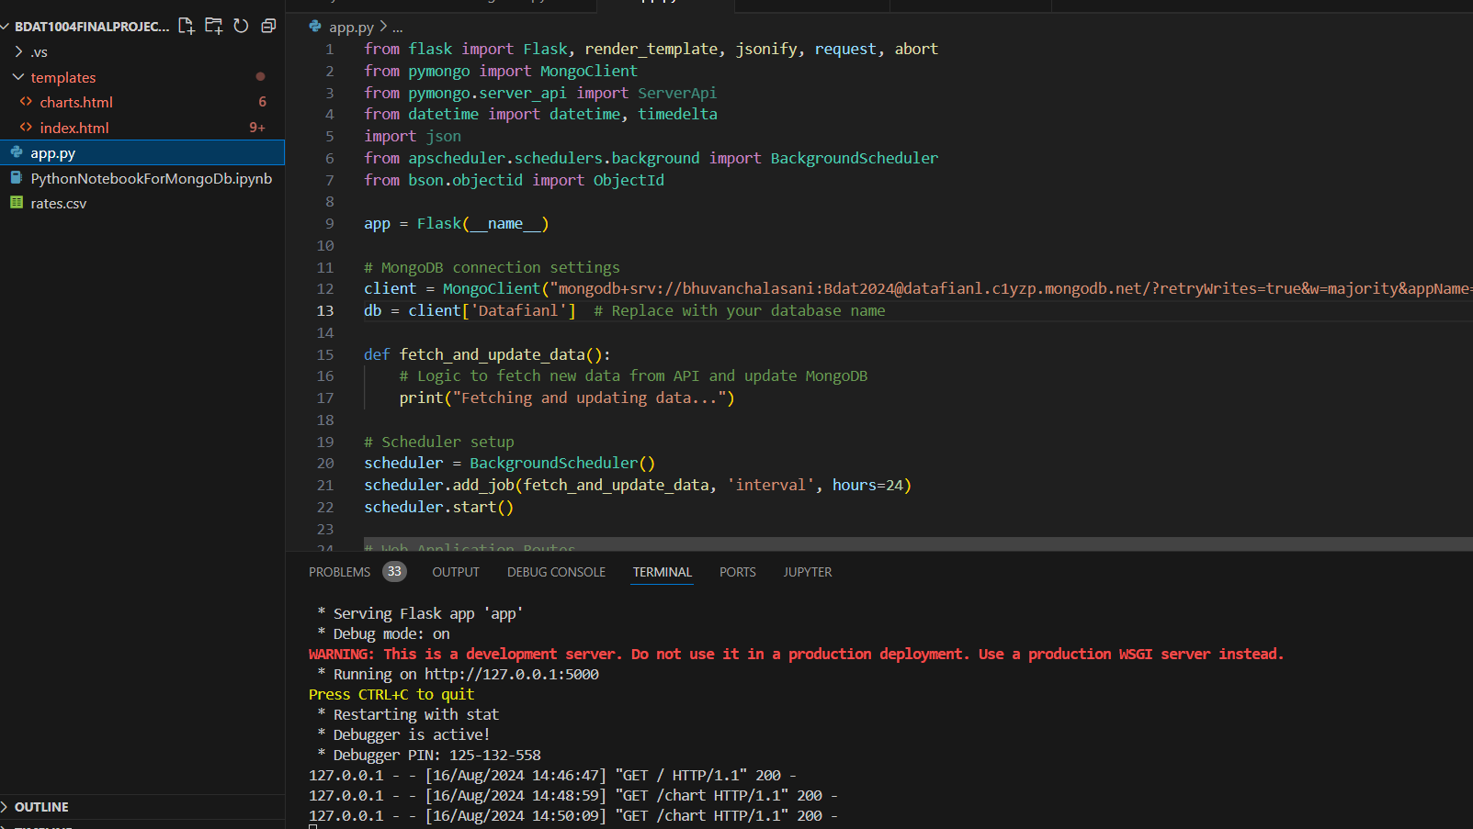
This screenshot shows a Python Flask application setup in Visual Studio Code. The code snippet includes the configuration for connecting to a MongoDB database using the MongoClient and the setup of a background scheduler using APScheduler. The scheduler is set to execute the fetch_and_update_data function every 24 hours, which is designed to retrieve new data from an API and update the MongoDB database. The terminal below shows the Flask application running in debug mode, with several HTTP GET requests being processed successfully. This setup is part of a web application that likely serves dynamic content based on the data stored in MongoDB.

Slide 18
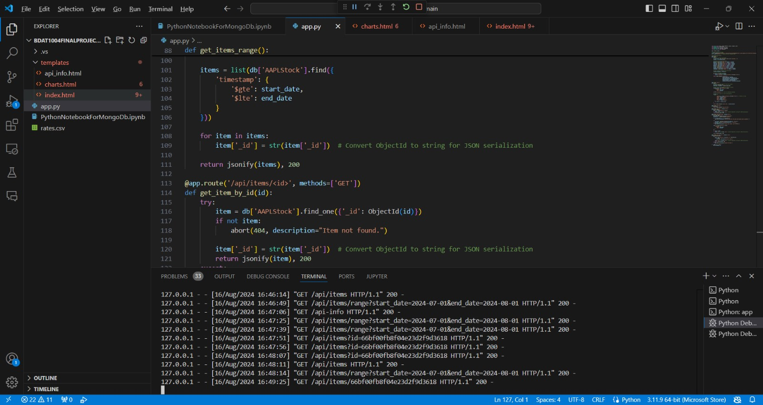
Running API Calls

Slide 19
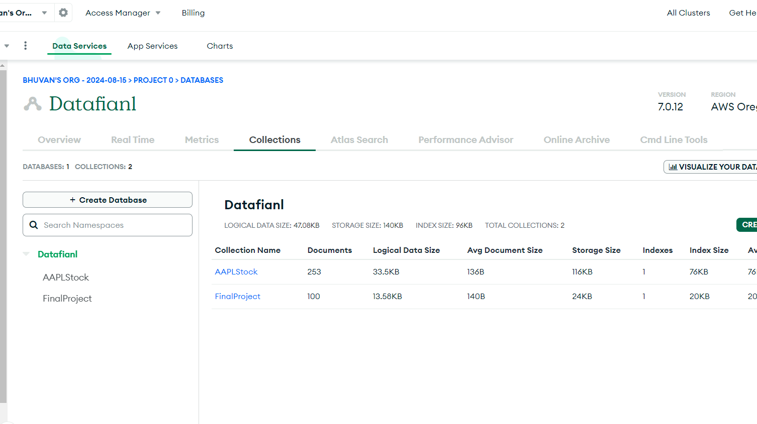
This screenshot shows the MongoDB Atlas interface for the database named "Datafian1." The database contains two collections: "AAPLStock" and "FinalProject." The "AAPLStock" collection has 253 documents, with a logical data size of 33.5KB and a storage size of 116KB. The "FinalProject" collection contains 100 documents, with a logical data size of 13.58KB and a storage size of 24KB. The interface also displays metadata such as the average document size and the index size for each collection. This dashboard provides an overview of the data storage and organization within the MongoDB database, managed through MongoDB Atlas.SE

Slide 20

THANK YOU

